Slide 1

STEM Academy
Fall 2020

Slide 2
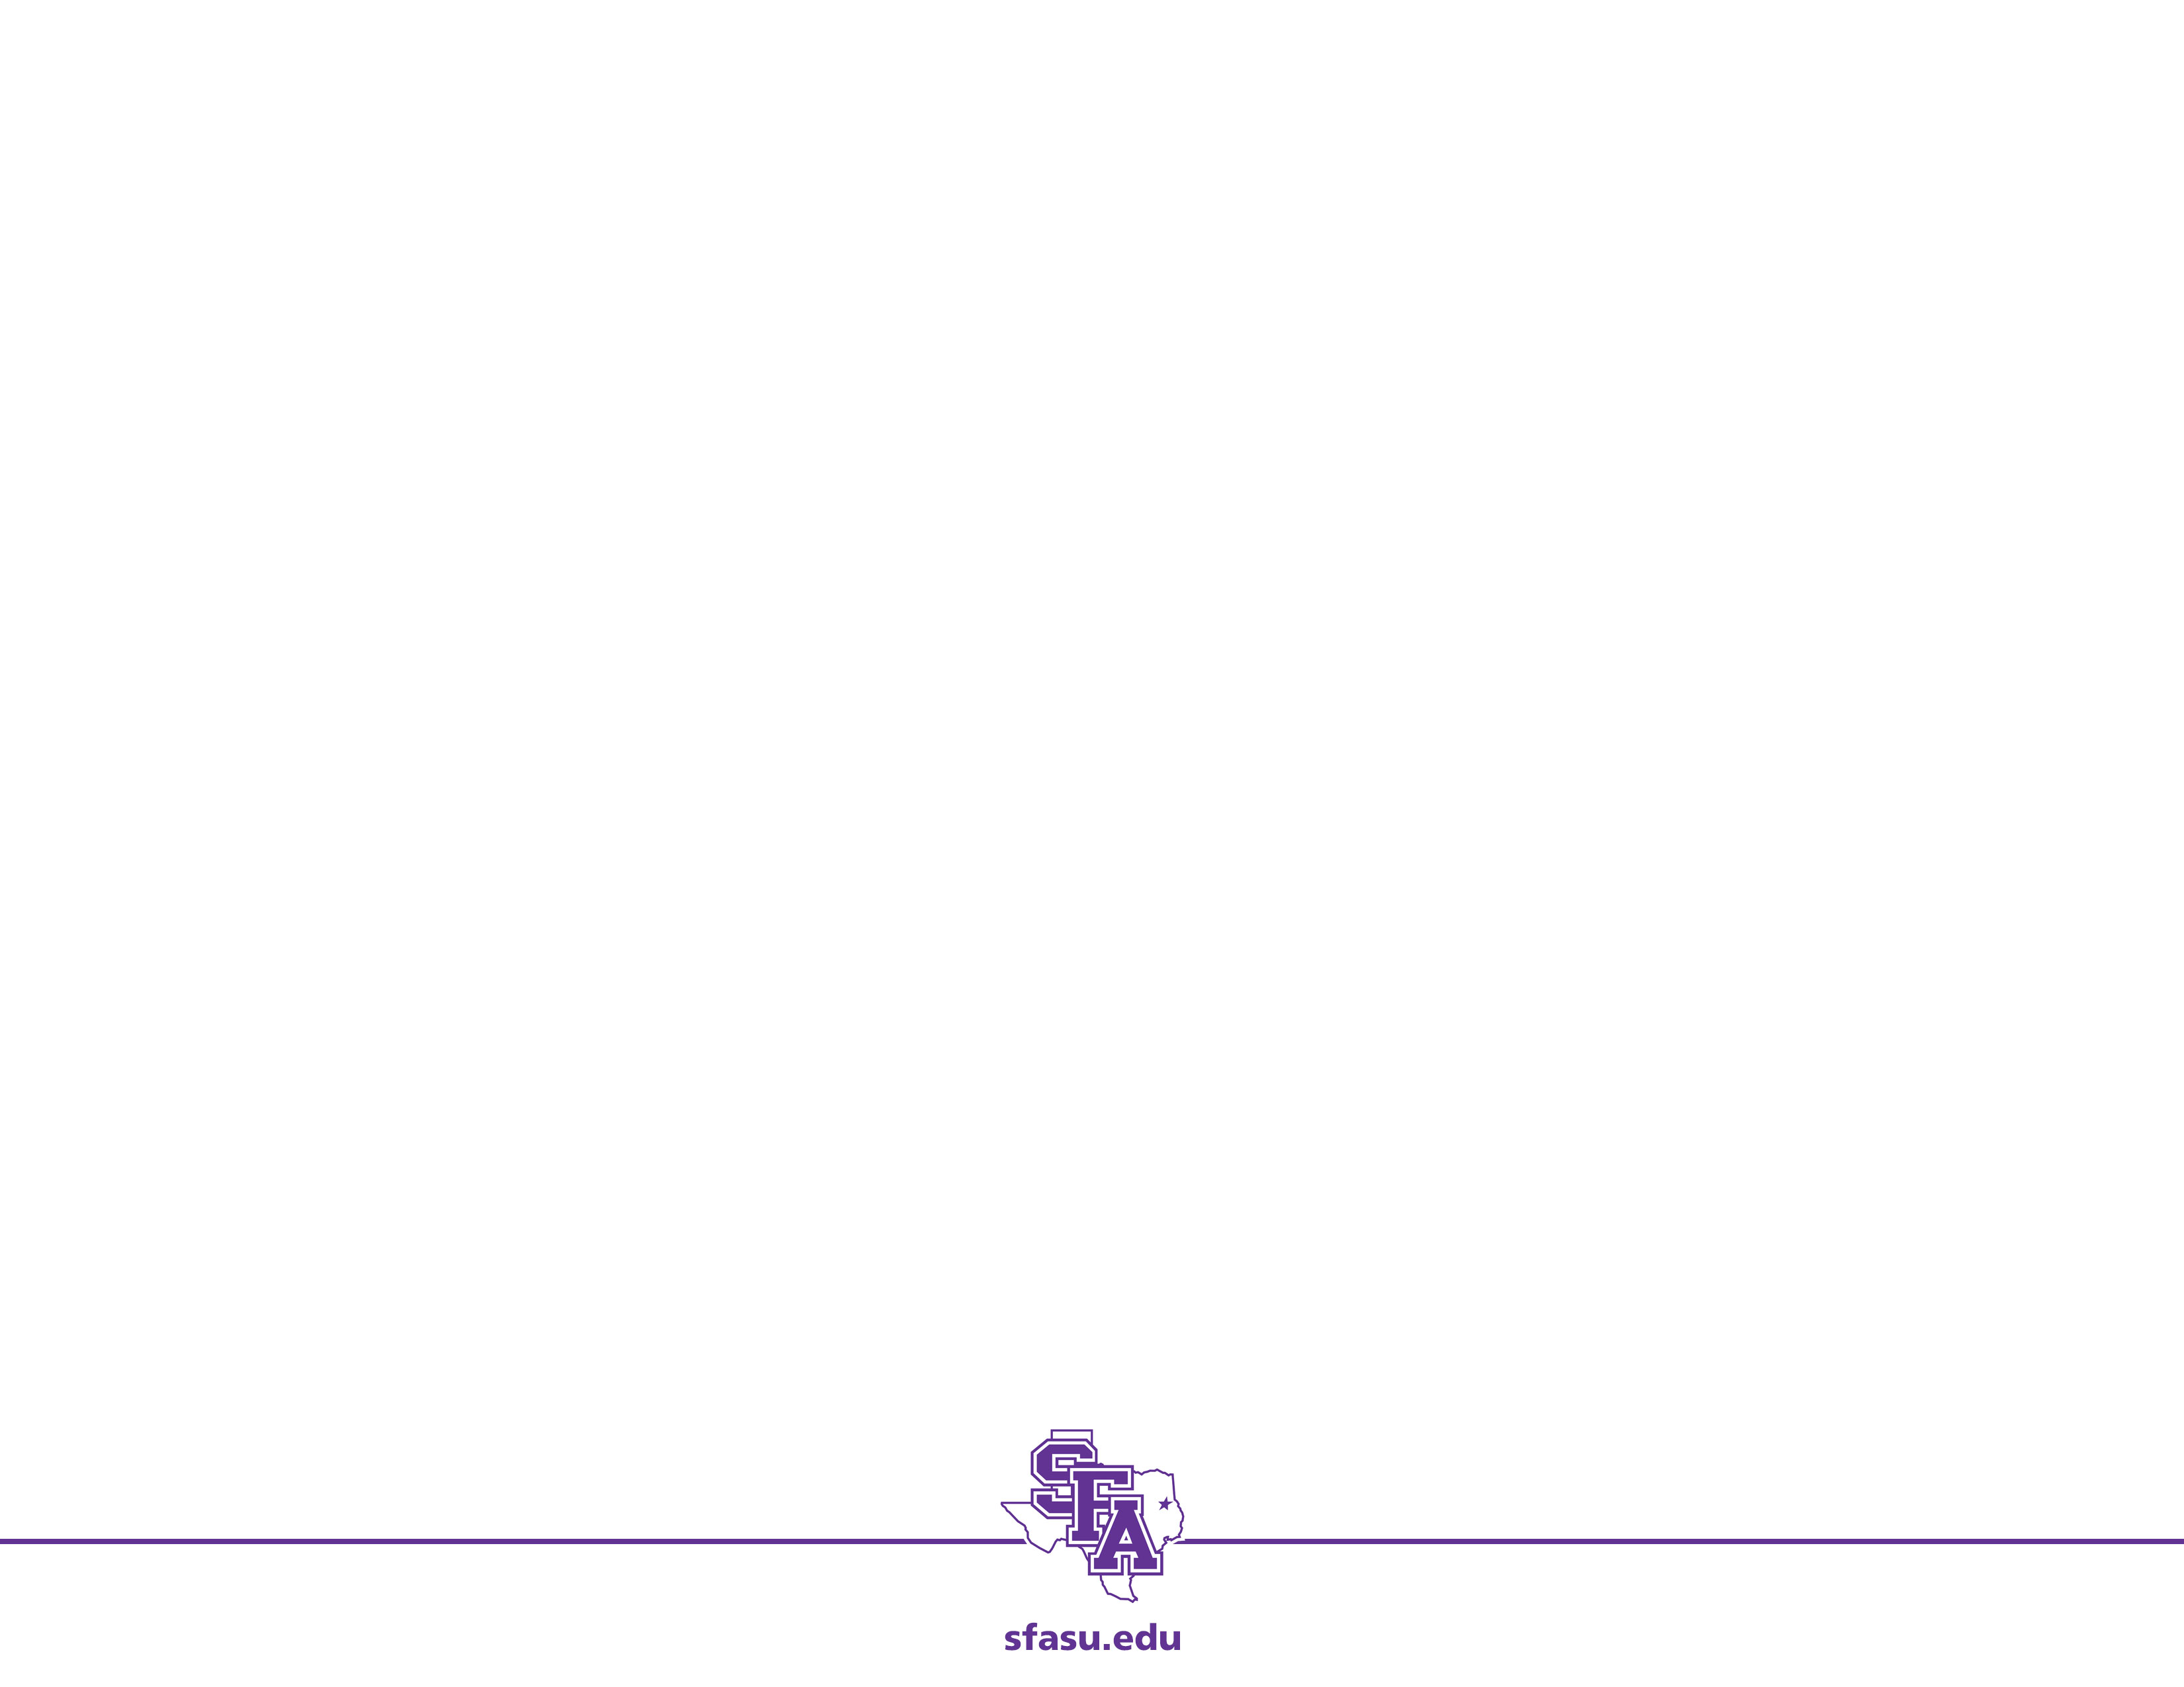
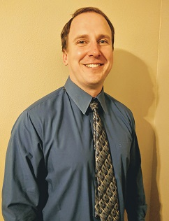
Me
What has two thumbs and loves Computer Programming?
This Guy: Dr. Becnel
Reviews:
We don’t have strong enough words to describe this professor.
- US News and Course Report
Everyone will get out of this class – a lot!
- NY Times Review of Course
We give this course two thumbs.
- Metametacritic

Slide 3
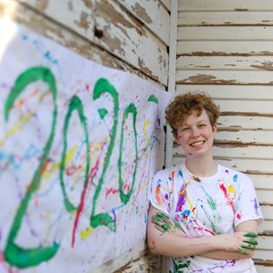
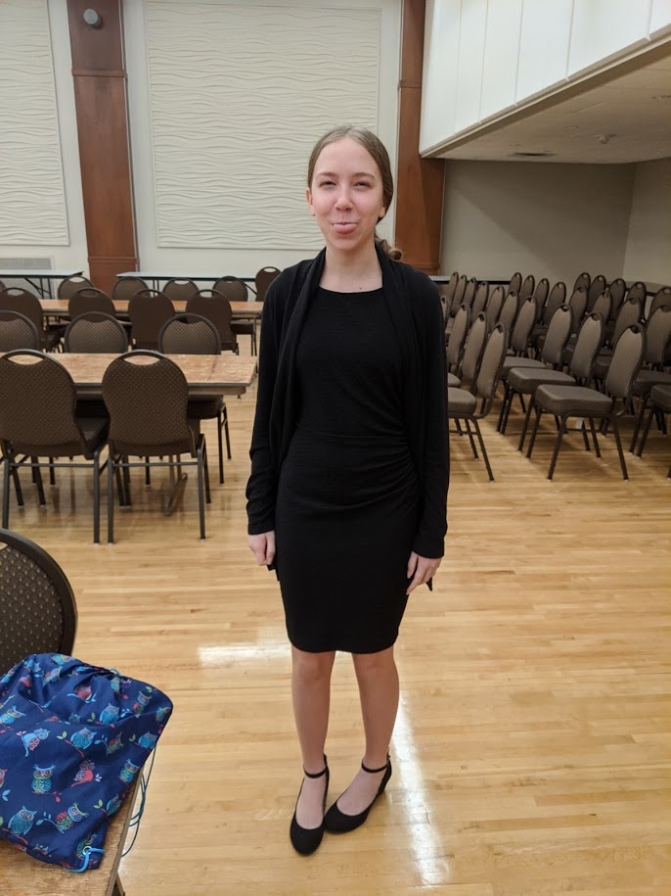
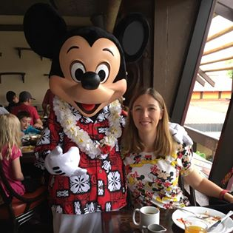
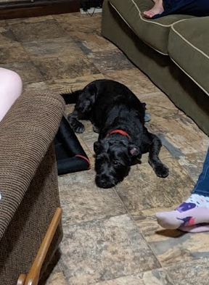
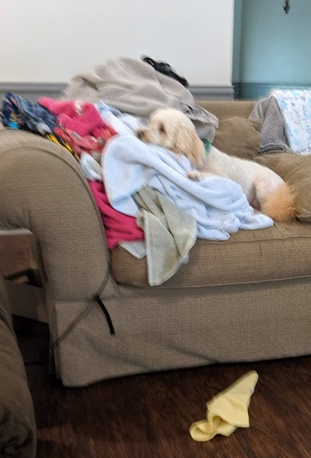
More Me

Slide 4
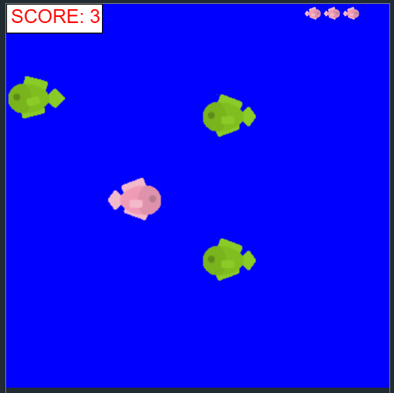
Today’s Goal: Fish Game
This is a simple game where the pink fish is controller by the player and tries to avoid the green fish. The player has three lives and a score is kept every time they avoid the fish.
We will learn about
Pixels/Graphics/Sprites
Events
If/then statements
Loops
Fish Game Finished Product

Slide 5
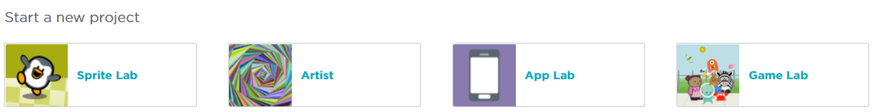
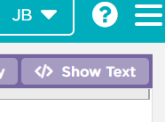
Getting Started
1. Open a web browser and go to https://code.org/
2. Click Sign-in at the top right and create an account.
3. Start a new project. Click: Game Lab
4. On the top right: click Show Text

Slide 6
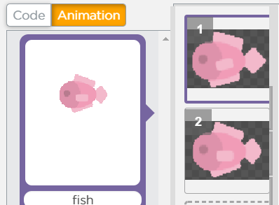
Sprites and Graphics
We will use a swimming fish animation:
Add animation for pink fish
Frames or Frames Per Second
Frame – contains all the video data that appears on screen
Frame per second – measurement of how fast the screen image changes
Animation – changes a picture with every frame
draw() – tells the computer what to draw on each frame
var fish = createSprite(50,200);
fish.setAnimation(“swim");
function draw() {
drawSprites();
}
Notes:
Name animation “swim”

Slide 7
Terminology
Computer Science Terminology
sprites – a computer graphic which may be moved on-screen and otherwise manipulated as a single entity
variables – named unit of storage that can be changed and accessed
objects – variables that represent something that can be manipulated
methods/properties – used to manipulate an object
functions – a group of statements that perform an action
var fish = createSprite(50,200);
fish.setAnimation(“swim");
function draw() {
drawSprites();
}
Notes:
“draw” is how we tell the what to draw each frame

Slide 8
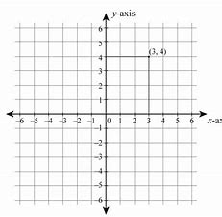
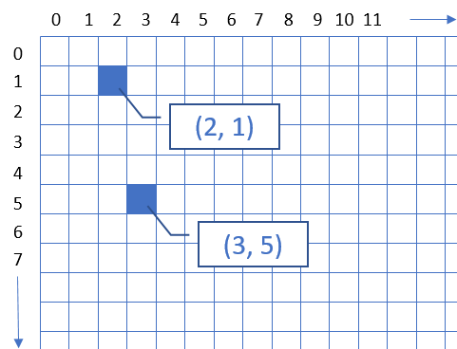
Math vs. Computer Graphics
var fish = createSprite(50,200);
Notes:
Parameters – information we pass to function

Slide 9
Things to do
Goal: Get the fish to move.
fish.velocityX, fish.velocityY - Try both with positive and negative numbers
Fix: background(“white”) - Try before and after drawSprites() - logical error
Fix: fish swimming backwards - flip pictures on animation
Fish starts at far left: - createSprite(0,200);
Notes:
Why does a positive velocity move down?
What happens when you put background after drawSprites()? (Paints over it.)
What should we set the parameters to in order for the fish to start at far left?
Background(“blue”);

Slide 10
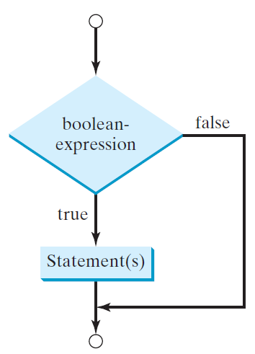
Starting over….if/then statements
Goal: Get the fish to reappear after it gets to the end of the “screen”.
How do we tell if tell when it reaches the end?
Conditional Statements
statements execute only when certain conditions are met
Boolean expression – something that is either True of False
True – statements are executed
False – statements are skipped
if (fish.x > 400) fish.x = 0;
if (boolean-expression) {
statement(s);
}
Notes:
How can we tell when the fish makes it to the end?
How should we start it over at the beginning?

Slide 11
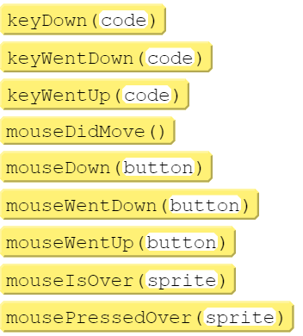
Events
Goal: Move the fish
We want to give the user some ability to alter the path of the fish.
Event - an action or occurrence detected by a program. Events can be user actions such as clicking a mouse button or pressing a button
Fish Movement
Detect when the user presses UP or DOWN if (keyDown(“up”))
Move the fish accordingly
fish.velocityY
Should this be positive or negative?
Notes:
Try fish.velocity = 0.5 first then
fish.velocityY = fish.velocityY -0.5;
= assignment operator
“Down” button

Slide 12
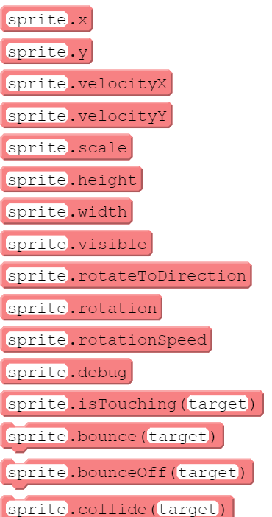
Problem: Keeping the fish visible
Problem: The fish flies off the screen!
Let’s look the methods and properties for sprites (the fish). Which can we use to tell when the fish has left the viewing window?
What do we want to do?
Code Blocks
A way to group statements together
Delimited by braces { }
If (fish.y < 0) { // reset the position // reset the velocity }
Notes:
How do we tell when the fish leaves the top/bottom of screen?
What do we want to do?
// don't go outside the window
if (fish.y < 0) {
fish.y = 0;
fish.velocityY = 0;
}
if (fish.y < 0) { fish.y=0; }
if (fish.y > 400) { fish.y = 400; }

Slide 13
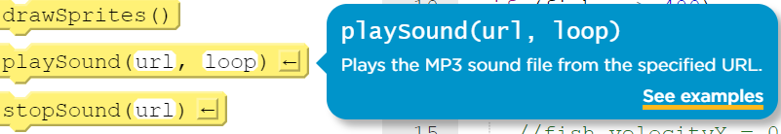
Sounds
Let’s add a swimming sound for our fish:
Parameter – information we give a function or method to help it perform an action
url – website with a sound "http://faculty.sfasu.edu/becneljj/splash.mp3"
loop – true if you want the sound to repeat; false otherwise
playSound("http://faculty.sfasu.edu/becneljj/splash.mp3", true);
Notes:
“draw” is how we tell the what to draw each frame

Slide 14
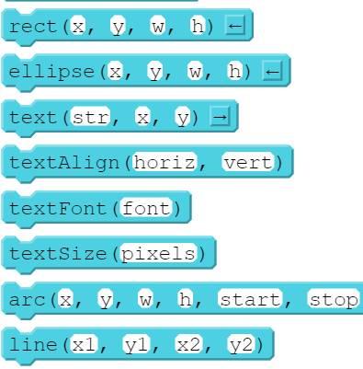
Score
Draw a Score on the canvas:
fill("white"); rect(0, 0, 100, 30); fill("red"); textSize(20); text("SCORE: " , 5, 20);
Tracking the score:
Global versus Local variables var score = 0;
Printing the score text("SCORE: " + score, 5, 20);
Incremented the code score = score + 1;
Notes:
Code block just puts the word Score
Where do you declare the scored variable?
When do we increment this?

Slide 15
subroutines
Subroutines/functions - a set of instructions, appearing once within a computer program but available for repeated use, for performing a specific task.
Make code more readable/easier to understand
Reduces errors
function displayScore() {
fill("white"); rect(0, 0, 100, 30); fill("red"); textSize(20); text("SCORE: " + score, 5, 20);
}
Notes:
displayScore is a name I pick.
Copy/Paste code

Slide 16
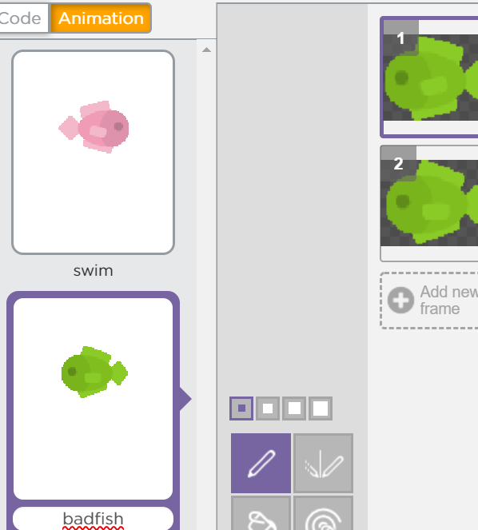
Enemy Fish
Create badfish Animation
Adding Enemy Fish
var badFish = createSprite(300, 200); badFish.setAnimation("badfish");
Moving the fish
badFish.velocityX = -1;
Random Position Generation
badFish.y = randomNumber(0, 400);
Create a function: drawEnemies()
Call this function at the start of each level
Notes:
if (fish.x > 400) {
fish.x = 0;
score = score + 1;
drawEnemies();
}

Slide 17
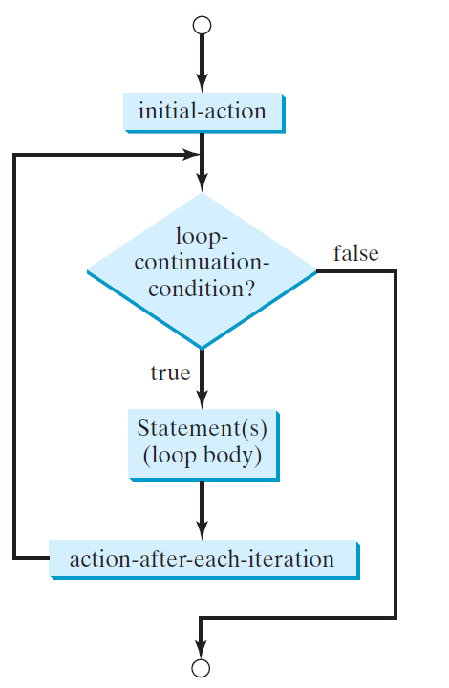
Loops
Loops – a set of instructions that repeats until a specified condition is reached
For loops – specify the number of times for instructions to happen
for (var i = 1; i <= 3; i=i+1) {
// do stuff
}
Let’s use the above to add 3 enemy fish.
Notes:
for (var i = 1; i <=3; i=i+1){
var badFish = createSprite(300, 200);
badFish.setAnimation("badfish");
badFish.y = randomNumber(0, 400);
badFish.velocityX = -1;
}

Slide 18
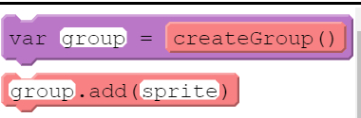
Groups/List
Group/List – holds a collection of similar objects
Let’s but our “bad fish” in a group.
var enemies = createGroup();
enemies.add(badFish);
Notes:
Where does each go? (var enemies at the top)
Enemies.add(badFish) in the drawEnemies method

Slide 19
Sounds
Swimming Sound
Death Sound
if (boolean-expression) {
statement(s);
}
Notes:
“draw” is how we tell the what to draw each frame

Slide 20
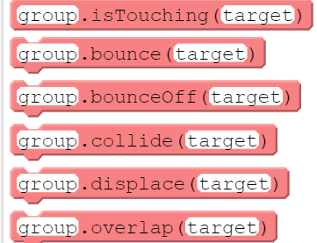
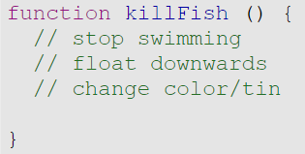
Collisions/Interactions
We would like our fish to be “killed” by an enemy fish.
Idea: When the fish gets close to an enemy, we
Stop swimming
Float down
Change color to indicate things went poorly
Comments – notes we leave to ourselves and members of our team to explain our code
Do not do anything
Super important though
// when our fish touches an enemy we // will kill the fish if (enemies.isTouching(fish)) // kill the fish
Notes:
Ask question: What would we like to do when collide?
function killFish () {
// stop swimming
fish.velocityX = 0;
fish.pause();
// float downwards
fish.velocityY = 2;
// change color/tint fish.tint = 'red'; }

Slide 21
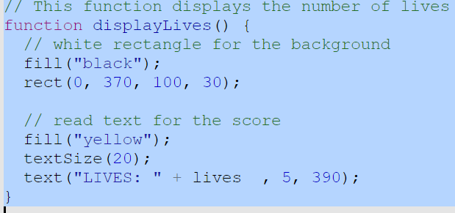
Fish Lives
How can we give the player “lives”? Let’s try to give them 3 chances. Global Variable
// the number of lives for the player var lives = 3;
When do we want to decrease the number of lives?
// reduce the number of lives - killFish() lives = lives -1;
Displaying the number of lives at bottom left?

Slide 22

Testing
Test the game.
Why are the lives not correct?
How do we fix?
Notes:
RUN the program
// when our fish touches an enemy we
// will kill the fish
if (enemies.isTouching(fish) && fish.velocityX > 0)
killFish();

Slide 23
Fish Lives
What should we do when player still has lives left?
// don't go outside the window
if (fish.y > 400) {
fish.y = 400;
fish.velocityY = 0;
// fish is dead
if (fish.velocityX == 0)
continueGame();
}
// This function continues the game
function continueGame() {
if (lives > 0) {
fish.destroy();
fish = createSprite(0,200);
fish.setAnimation("swim");
fish.velocityX = 2; playSound("http://faculty.sfasu.edu/becneljj/splash.mp3", true); }
}
Notes:
continueGame( )

Slide 24
Fish Lives
What should we do when the player runs out of lives?
// if the lives reach 0, let the
// user know that the game is over
if (lives == 0)
gameOver();
// Display that the game is over
function gameOver() {
fill("red");
rect(150, 200, 100, 30);
// read text for the score fill("black");
textSize(20);
text("GAME OVER" , 155, 220);
}
Notes:
==

Slide 25
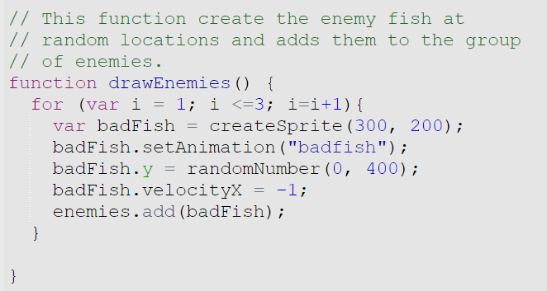
Extensions - Levels
Change the number of enemies based on the score
Right now we always create 3 enemy fish
Keep track of the number of “levels” and create fish based on this
Increase the number of fish every 3 levels Levels 1,2,3 – 1 fish Levels 4,5,6 – 2 fish Levels 7,8,9 – 3 fish . . .
Notes:
Can do the score / 3.
Or you can add a variable called level.

Slide 26
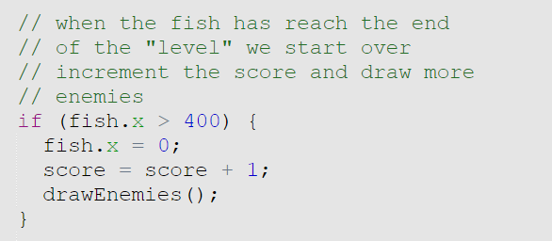
Extensions – Adaptive Score
Change the score given based on the level
Right now we always add 1 to the score.
Use the “levels” we created and increment the number of fish based on the enemies they circumvent.
Notes:
We know how many fish are created with each level…based on that let’s increment the score.

Slide 27
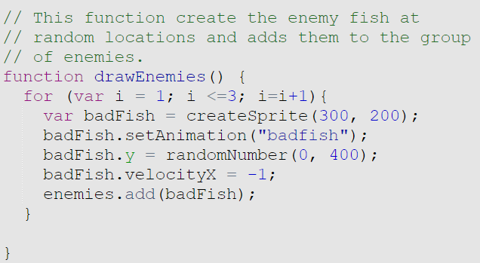
Extensions – Random Swimming
Have the enemy fish swim in a random up/down direction and not simply straight across.
Notes:
“draw” is how we tell the what to draw each frame

Slide 28
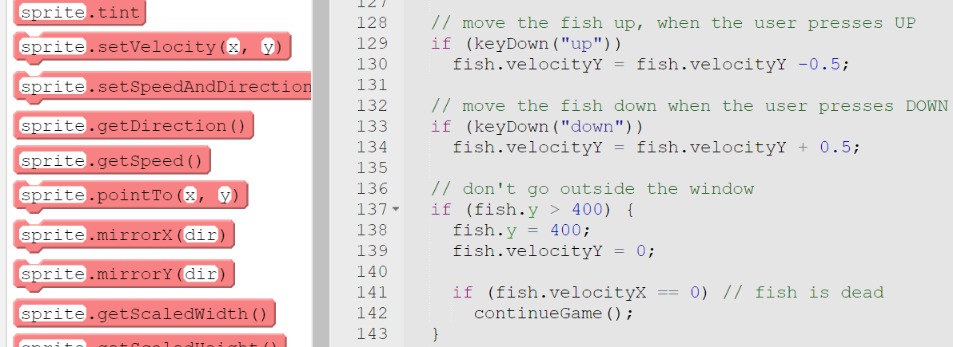
Extensions – Left/Right Controls
Let the user move the fish left and right
Set the fish velocity to be 2 or -2 when the user pressing the right or left arrow
Mirror the sprite so that the fish is swimming in the correct direction.
Notes:
“draw” is how we tell the what to draw each frame

Slide 29
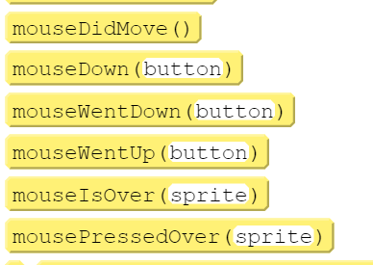
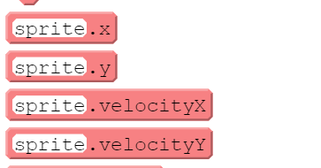
Extensions – Click on Bad Fish
Clicking on Enemy Fish to changes the direction they are swimming
Detect when the user clicks an enemy fish
Change the velocity of the enemy fish to a different random.

Slide 30
Extensions - Bubbles
Add bubbles coming out of the fish mouth when it crosses half-way
Create a bubble sprite
Detect when the fish has made it half-way and create a bubble that will float up
Hint: The hard part is to figure out how to create only one bubble.

Slide 31
Extensions – Be Creative!
Change the game or add something to it!
Example: Mouse Click Game
Good fish moves randomly
The user clicks on the enemies to “kill” them
The user gets a point for each enemy killed
Change the score based on fish clicked
Death animation for enemy fish when clicked
Example: Shooting Game
Control the good fish
Clicking shoots a bubble at the enemy fish
Change the score based on fish shot

